Slide 1




COMPARATIVE ANALYSIS OF MACHINE LEARNING AND DEEP LEARNING MODELS FOR EEG-BASED SCHIZOPHRENIA DETECTION

Slide 2

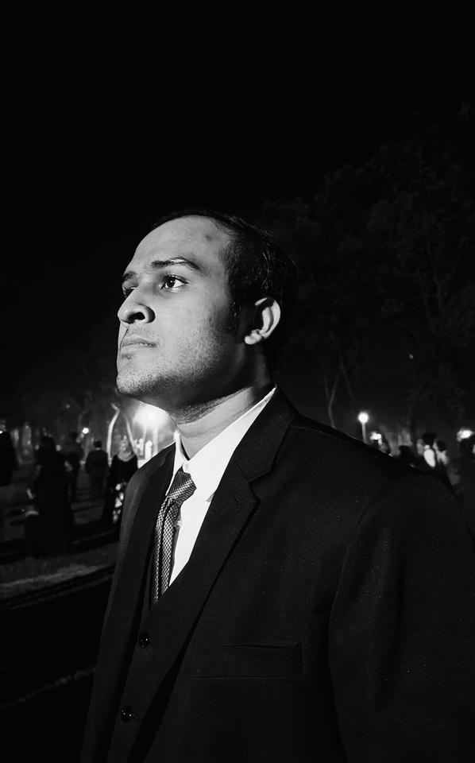

Faiyaz Bin Yousuf
Asief Iqbal Dieyaz
ID-22101845
ID-23341081

Slide 3
DATASET ANALYSIS
Dataset Groups
14 Schizophrenia partient (7 male and 7 female) & 14 Healthy control ( 7 male & 7 female)
Male Patients: 24.6-31.2 years, Female Patients: 24.2-32.4 years.
EEG Analysis
Resting state with closed eyes, recorded for 15 minutes using standard 10–20 EEG montage with 19 channels.
Segmentation into 30-second intervals, second-order Butterworth filter applied, isolation of five frequency bands,
Data sampling rate of 240 Hz.

Slide 4
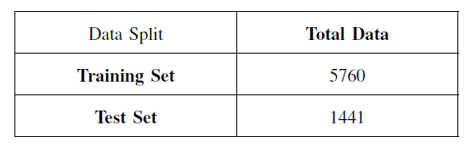
METHODOLOGY
Feature Extraction
Categorization: Two discrete groups – healthy and patients
Features: 7201 features derived from diverse mathematical functions.
Train Test Split: 80:20 split for model evaluation (5760 features for training, 1441 features for testing).
Machine Learning Algorithms
Feature scaling: StandardScaler pipeline | Hyperparameter tuning : GridSearchCV
SVM(Linear, Polynomial and RBF kernel)
Random Forest, XGBoost, and Decision Tree models hyper parameter tuning: maximum depth, number of estimators, and learning rate

Slide 5
METHODOLOGY
CNN Architecture
3 Layered 1D CNN with a fully connected dense layer
Batch normalization, LeakyReLU activation function, MaxPooling1D, and Dropout
Adam optimizer and Binary Crossentropy loss function.
1D CNN
filters=32
kernel_size=5
input_shape=(1250, 19)
BatchNormalization
LeakyReLU MaxPooling1D
Dropout(0.3)
1D CNN
filters=64
kernel_size=3
BatchNormalization
LeakyReLU
MaxPooling1D
Dropout(0.3)
1D CNN
filters=128
kernel_size=3
BatchNormalization
LeakyReLU MaxPooling1D
Dropout(0.3)
Flatten()
Dense(256, activation='relu') Dropout(0.5))
Dense(1, activation='sigmoid')

Slide 6
Data Noise Filtering
Health and Patient Group
Hyperparameter Tuning
Data Preprocessing
3 Layer 1D CNN
Feature Extraction
80:20 Train Test split
Model Training and Evaluation
CNN
Fully connected dense layer
METHODOLOGY
Machine Learning Models
Decision Tree
XGBoost
Logistics Regression
KNN
SVM
(Linear, poly,rbf )
Random Forest

Slide 7
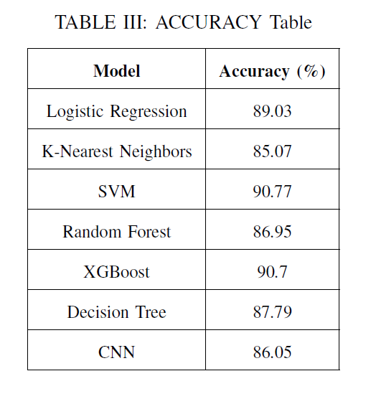
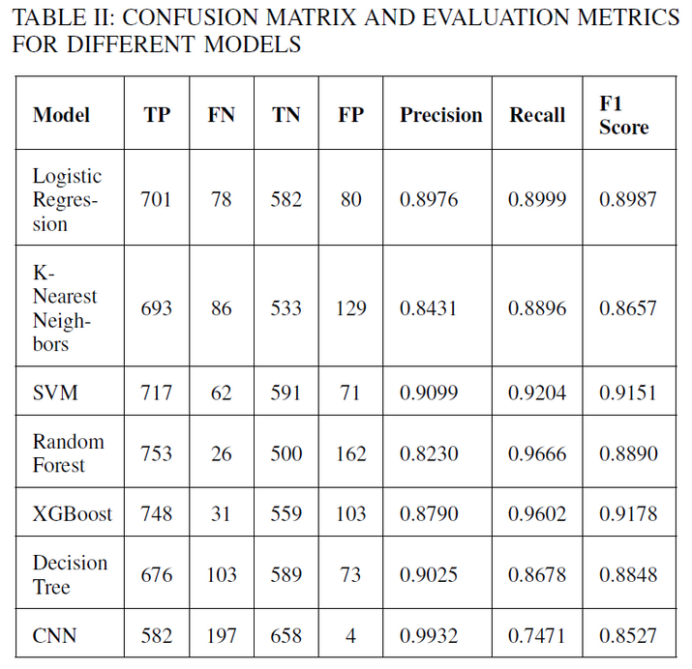
RESULT & DISCUSSION
Model Evaluation Metrics:
Confusion matrix and evaluation metrics for each model.
Top Performing Models:
SVM and XGBoost with accuracy of 90.77% and 90.7% respectively.
Logistic Regression with 89.03% accuracy.
Deep Learning Model:
CNN demonstrated substantial performance with an accuracy of 86.05%.
Model Strengths:
SVM's exceptional performance in EEG analysis for schizophrenia detection.
CNN's effectiveness with its multi-layered neural architecture.
XGBoost showcasing adaptability and competitiveness.

Slide 8
CONCLUSION
Top Performing
Models
Strengths of ML Models
Future Scope
SVM and XGBoost stand out with superior accuracy, precision, recall, and F1 score.
CNN also exhibits exceptional accuracy and precision.
Each model demonstrates unique advantages.
Choice depends on specific application requirements, balancing accuracy, precision, and recall.
Explore ensemble methods or hybrid models for more robust and accurate schizophrenia detection systems.
Potential for faster EEG analysis in real-time applications, especially with wearables and smartphones.

Slide 9
Thank You

